Slide 1
LDPS IV FM Receiver Project
PENG YOUN TAN
TEDDY NG
HERMAN YAU

Slide 2
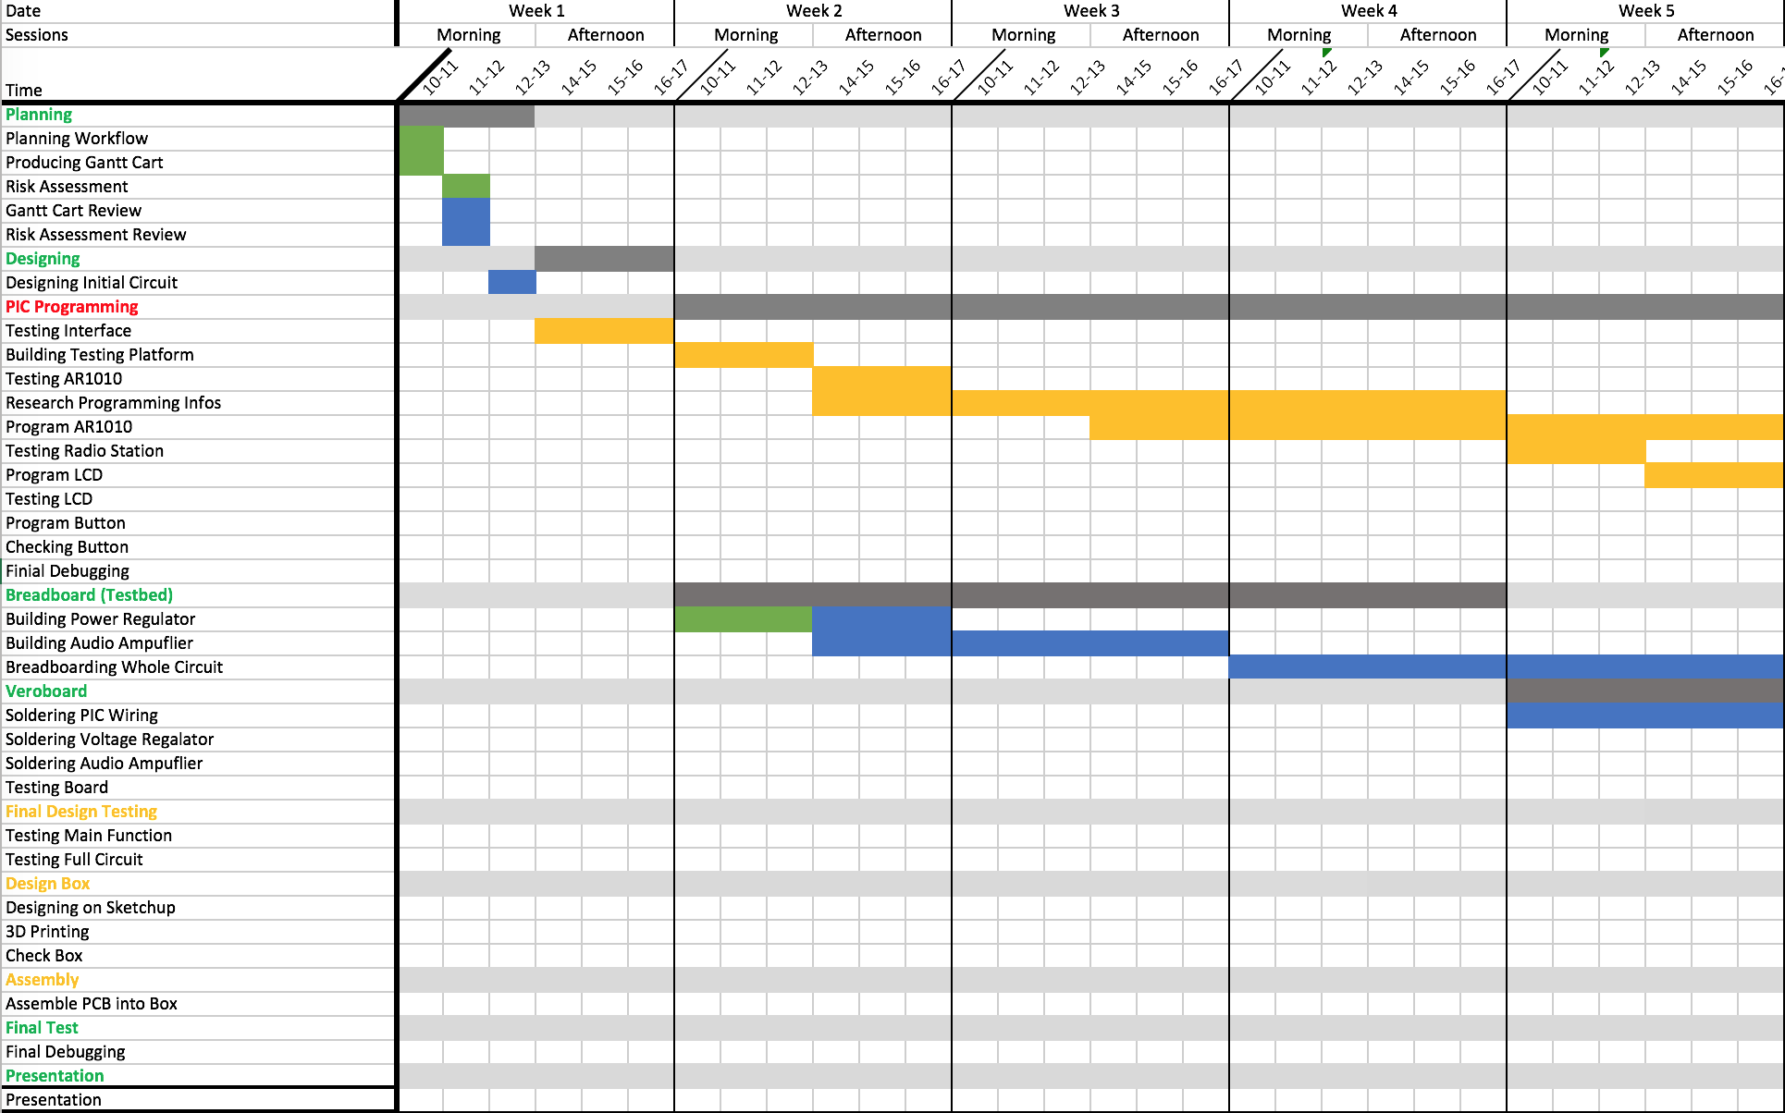
Gantt Chart

Slide 3
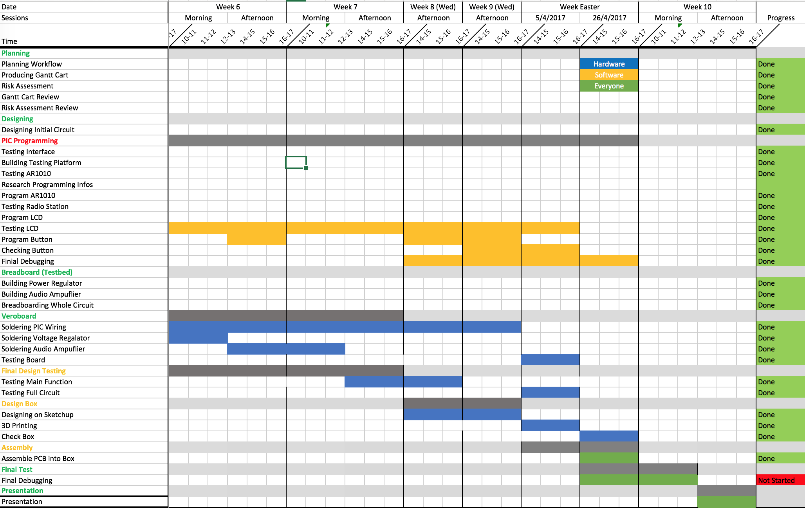
Gantt Chart (cont’d)

Slide 4
Specification (Hardware)
3 x 1.5V AA batteries Matrix Board Implementation Multiple output options: TRS jack socket output Built-in stereo speaker output

Slide 5
Specification (Software)
Channel switching: Manual tune Auto tune 4 preset frequencies Frequency Range: 87.5MHz -108 MHz Frequency and volume display Volume change functionality

Slide 6
Hardware
Power Block: Regulates voltage supply
Amplifier Block: Amplifies audio signal to audible level
Microcontroller Block: Connects to FM Receiver chip and other misc. I/O

Slide 7
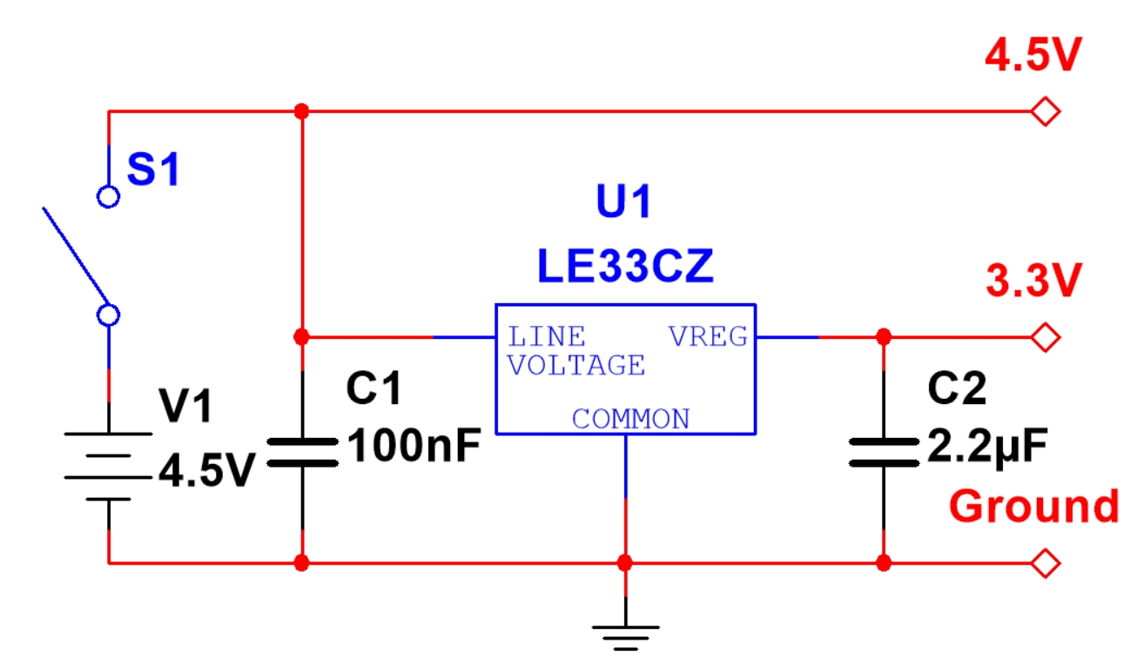
Power Block

Slide 8
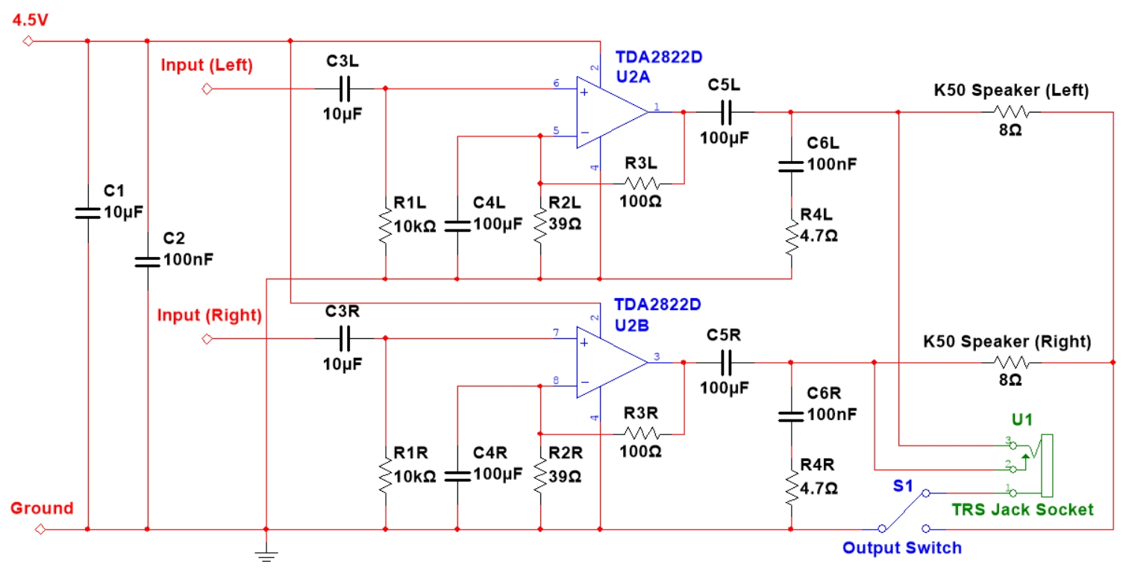
Amplifier Block

Slide 9
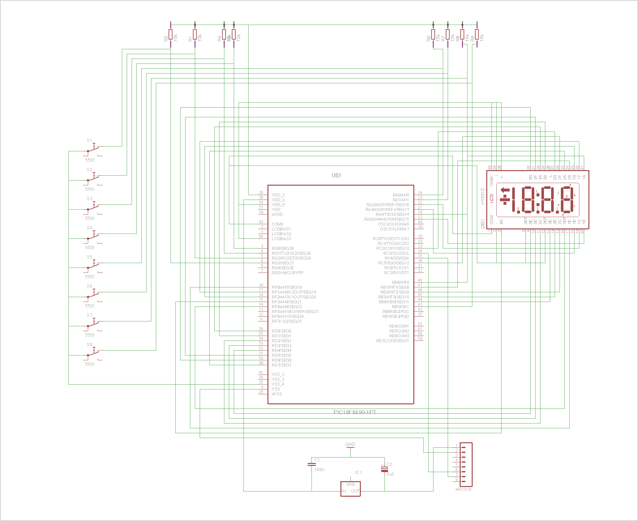
Microcontroller Block

Slide 10
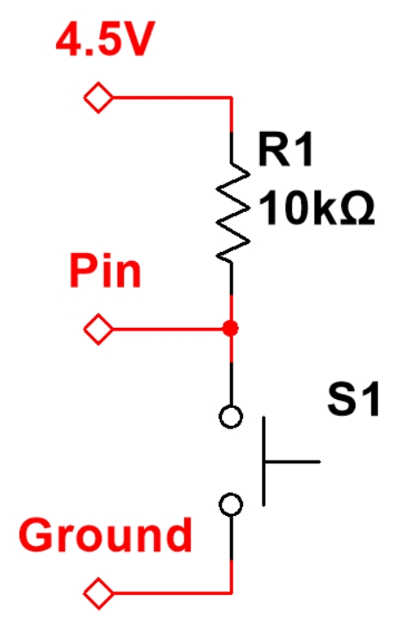
Microcontroller Block (cont’d)

Slide 11
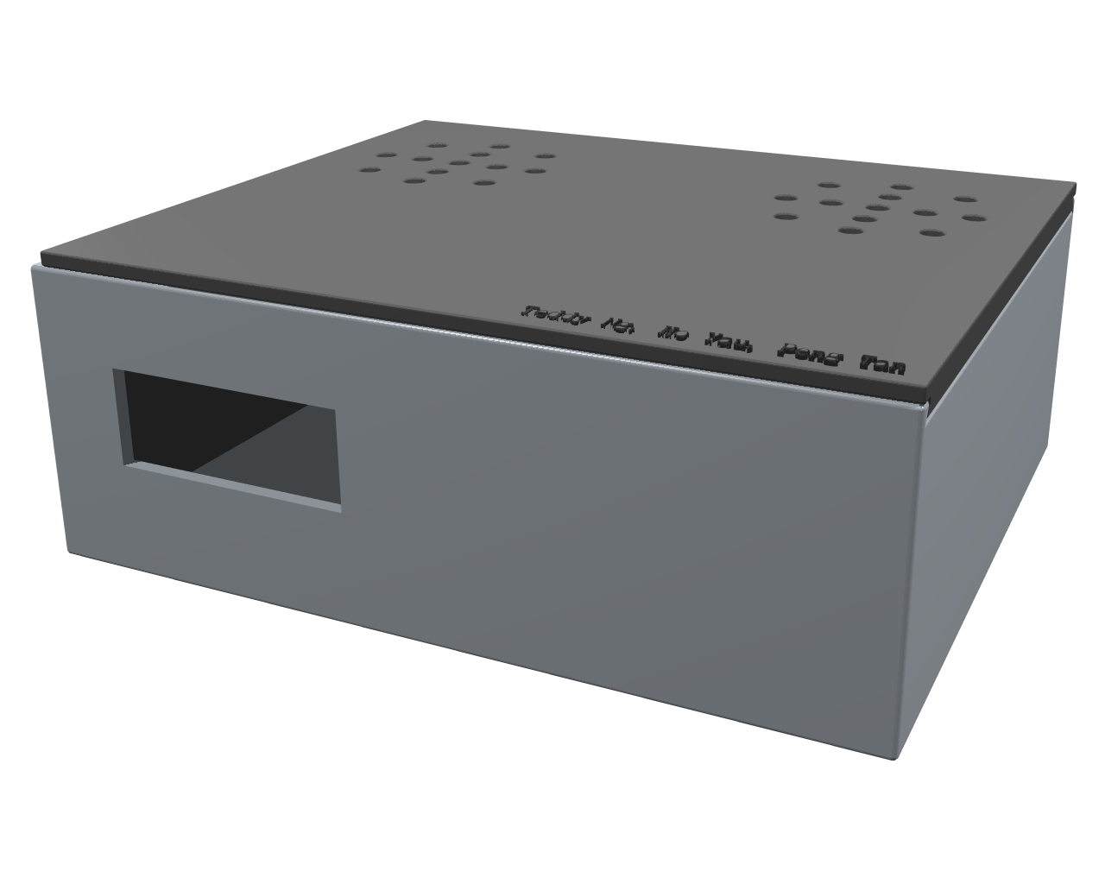
Implementation of Enclosure

Slide 12
Initial Research
PIC18LF6490 Microcontroller I²C Protocol, SCL and SDA buses only Seven-segment Display Programming Pushbuttons Programming

Slide 13
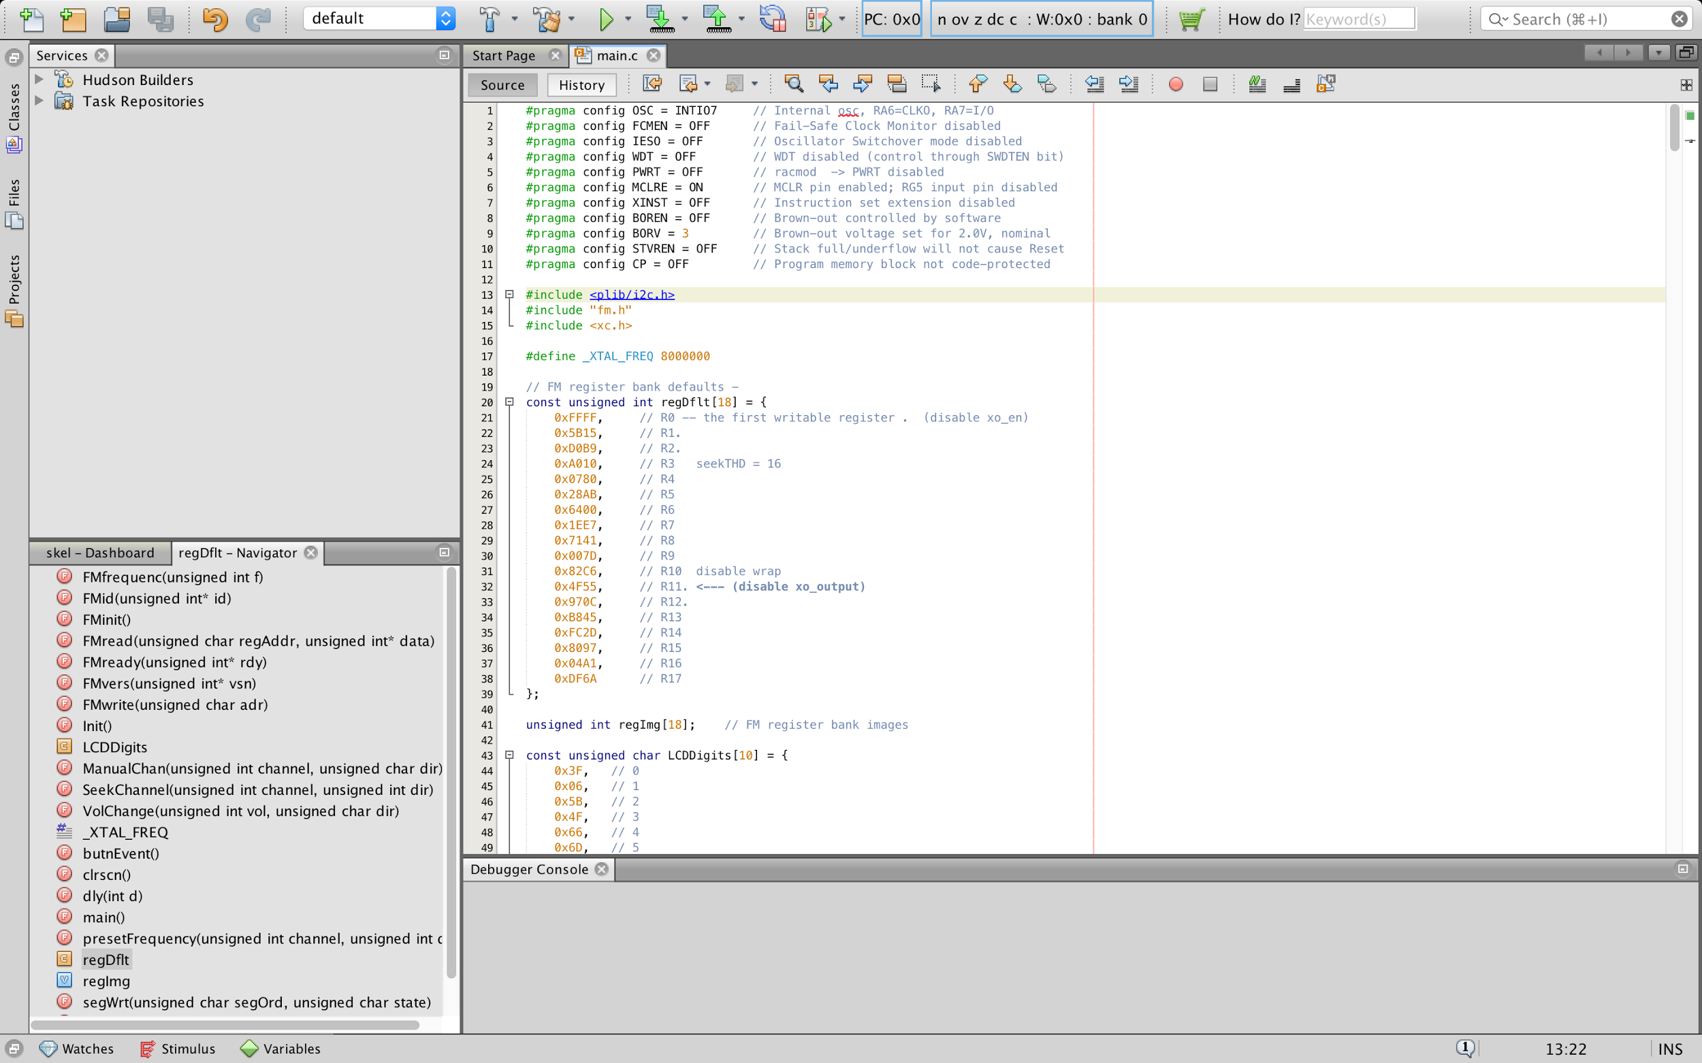
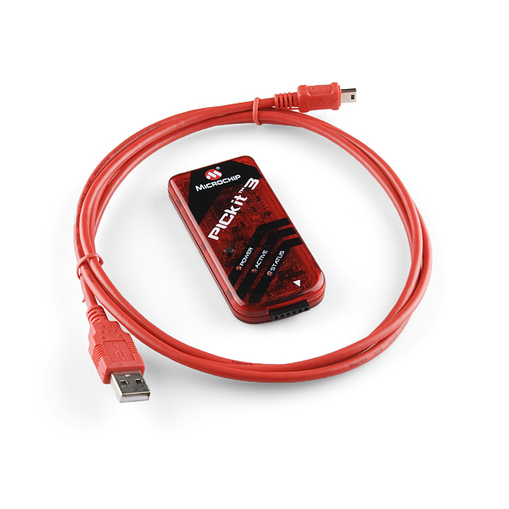
Development Platform

Slide 14
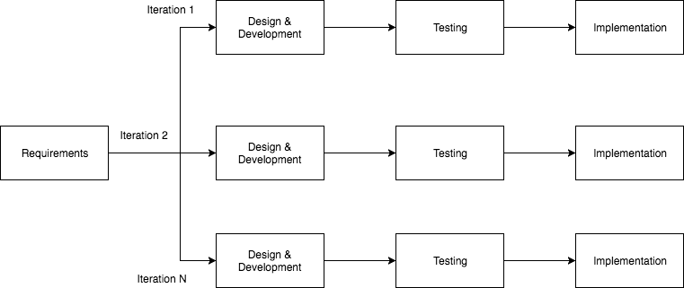
Incremental Model

Slide 15
Future Improvements
Implementation of Power-Managed Operation
Implementation of Tone Control

Slide 16
Thank you for your time!
Any questions?

